Slide 1
Basic React Native Components + Stylesheets

Slide 2

Vanilla React Native uses
Babel as a preprocessor
ES6
ECMAScript 6
JSX
Extension
+
Notes:
So we just briefly explained why enabling something like ES6 is important.
What about….

Slide 3
Vanilla React Native uses
Babel as a preprocessor
ES6
ECMAScript 6
JSX
Extension
+
Notes:
First, what does it mean to enable ES6 support?

Slide 4

ES6 (ECMAScript 6)
Cleaner (fat arrow) functions.
var _this = this; var foo = function foo() { return 'bar'; }; var baz = function baz(x) { return x + 1; }; this.items.map(function (x) { return _this.doSomethingWith(x); });
const foo = () => 'bar' const baz = (x) => { return x + 1 } this.items.map(x => this.doSomethingWith(x))
Notes:
We saw how Babel preprocessor works with ES6

Slide 5
Vanilla React Native uses
Babel as a preprocessor
ES6
ECMAScript 6
JSX
Extension
+
Notes:
What about JSX?

Slide 6



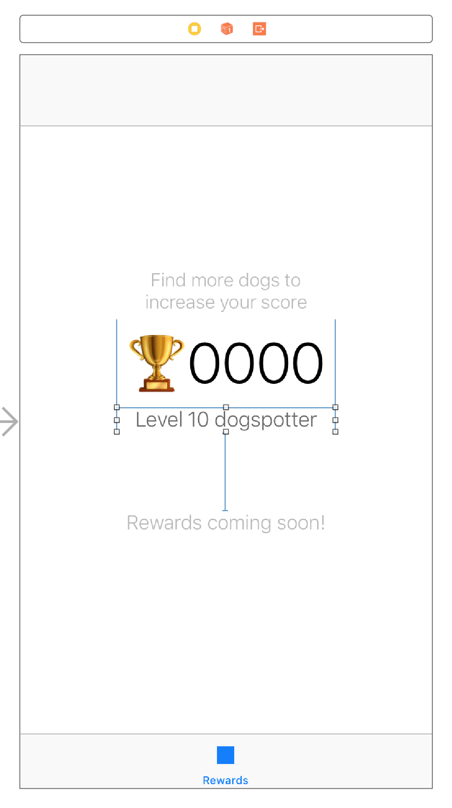
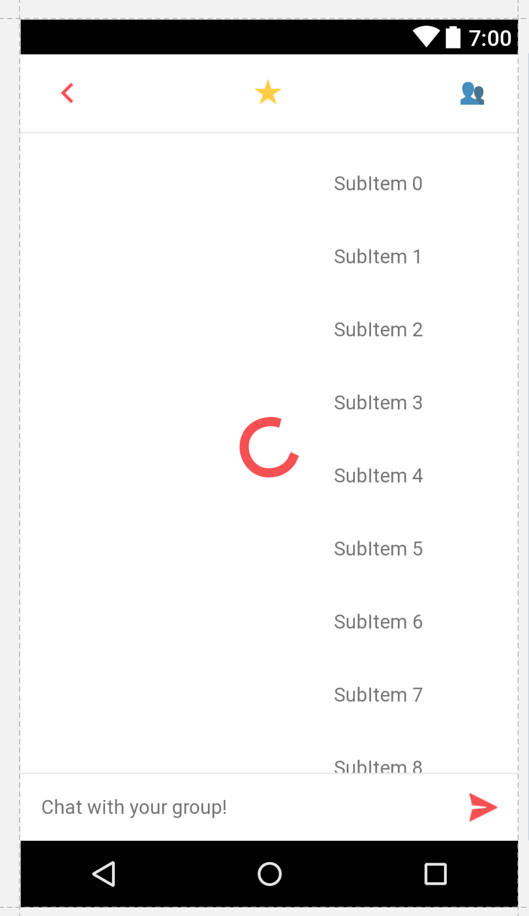
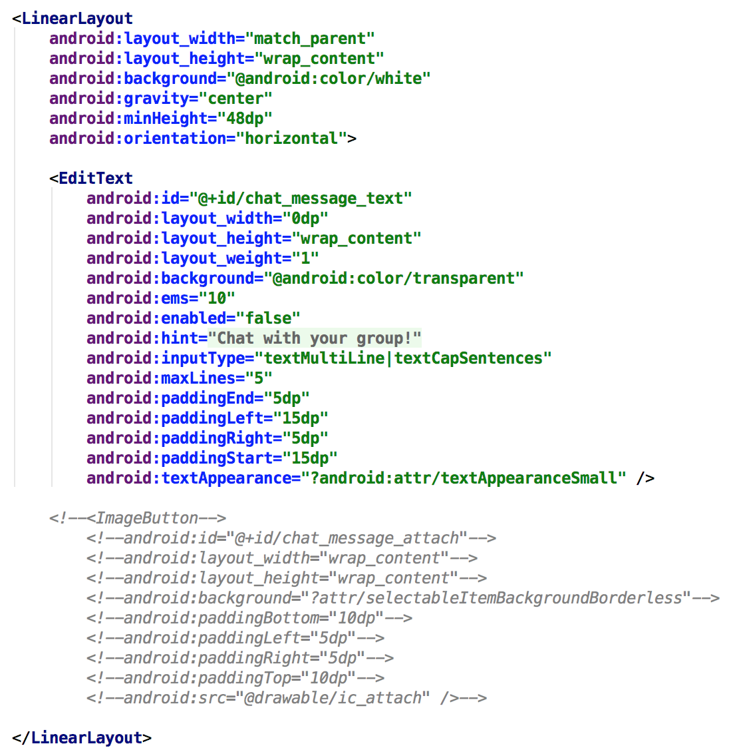
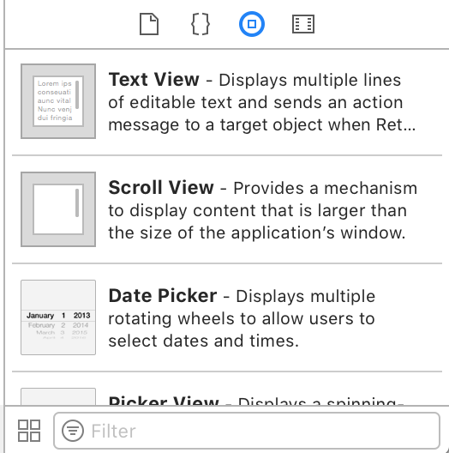
let textLayer = CATextLayer() ... self.view.layer.addSublayer(textLayer)
const ourNestedView = ( <View foo='bar'> <Text>42</Text> </View> )
Notes:
Building a layout with JSX once and having it work on both iOS and Android is priceless.
Imagine all of the time you saved.

Slide 7
const styles = StyleSheet.create({ container: { flex: 1, backgroundColor: '#fff', alignItems: 'center', justifyContent: 'center', }, });
Basically “CSS” brought to a mobile platform
https://github.com/vhpoet/react-native-styling-cheat-sheet
Notes:
Towards the end, we looked at styling React Native, but we kept it to the basics

Slide 8
Components
Different classes that inherit from the React Component class

Slide 9
Components
Different classes that inherit from the React Component class
Importance: renderable!

Slide 10
Components
Different classes that inherit from the React Component class
Importance: renderable!
Common Components:
View
Text
Image
Lists
Scrollviews
Touchables

Slide 11
Components
Different classes that inherit from the React Component class
Importance: renderable!
Common Components:
View
Text
Image
Lists
Scrollviews
Touchables

Slide 12


View
Most common visual styles
Common uses: wrapper around images, background, layout control
backgroundColor: “red”
borderWidth: 2
borderColor: “green”
borderRadius: 10
opacity: 0.3

Slide 13





View
Using the different styles we can get pretty interesting shapes
Notes:
Questions?

Slide 14
Text
Not the most interesting component, but still useful...
color: “red”
fontWeight: “bold”
fontSize: 16
fontFamily: “Helvatica”
backgroundColor: “black”

Slide 15
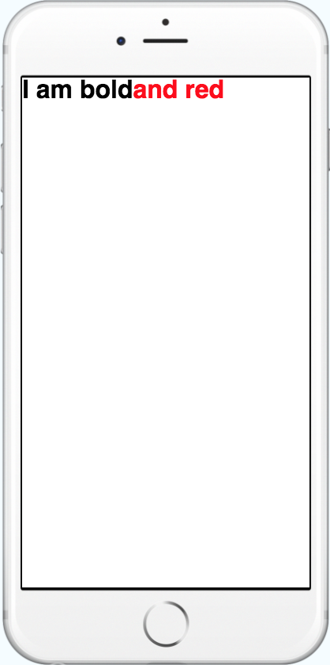
Text
Text allows nesting
<Text style={{fontWeight: 'bold'}}>
I am bold
<Text style={{color: 'red'}}>
and red
</Text>
</Text>

Slide 16
Text
Has an onPress and onLongPress handlers
<Text onPress=() => console.log(“bold clicked”)
style={{fontWeight: 'bold'}}>
I am bold
<Text style={{color: 'red'}}>
and red
</Text>
</Text>
Notes:
Questions?

Slide 17
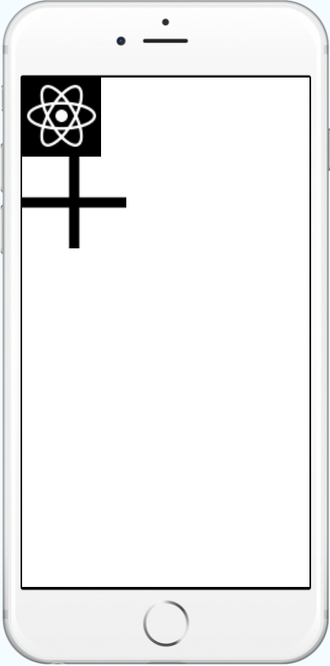
Image
Surprise! Used to display images
Uses URI or Assets to display the photos
<Image style={{width: 50, height: 50}}
source={{uri: 'https://facebook.github.io/react-native/ docs/assets/favicon.png'}}/>

Slide 18
Image
Surprise! Used to display images
Uses URI or Assets to display the photos
<Image source={require('/react-native/img/favicon.png')}/>

Slide 19

Image
You can specify the resize mode of the image
<Image resizeMode=“stretch” source={{...}}/>
<Image resizeMode=“cover” source={{...}}/>
<Image resizeMode=“contain” source={{...}}/>
<Image resizeMode=“repeat” source={{...}}/>
Notes:
Stretch, doesn’t keep aspect ratio
Cover is like Crop
Contain is like fit
Repeat tiles
Questions?

Slide 20
Components
Different classes that inherit from the React Component class
Importance: renderable!
Common Components:
View
Text
Image
Lists
Scrollviews
Touchables
Notes:
So far so good?

Slide 21
Coordinates
Container: { position: ‘absolute’, start: 0, top: 0, width: 50, height: 50 . . . }

Slide 22

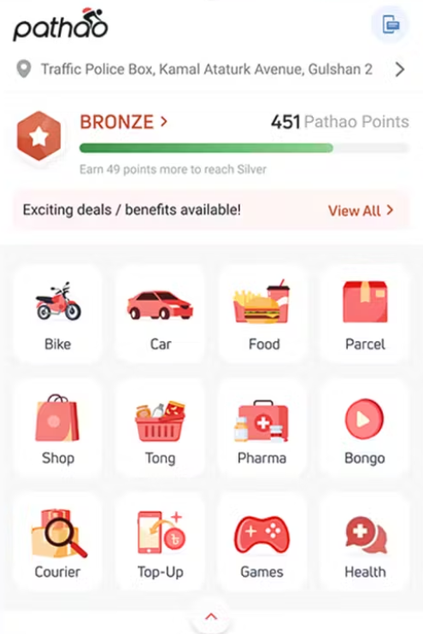
Coordinates

Slide 23
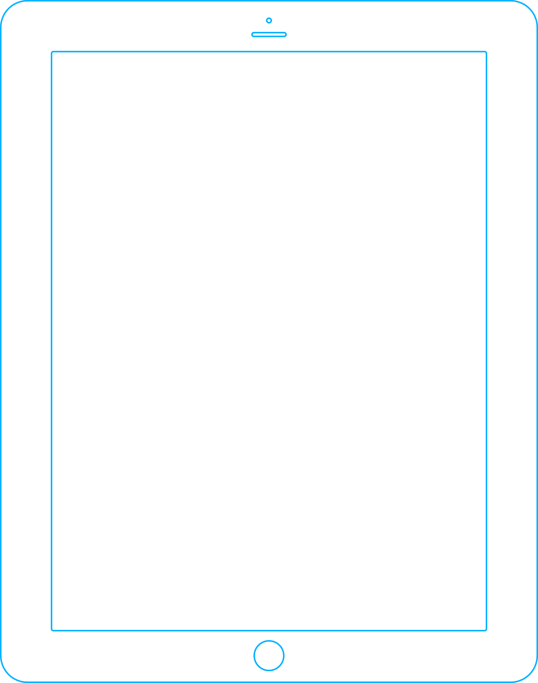
Coordinates
Notes:
No contact between child and parent

Slide 24
Relative, percentages
Container: { start: ‘10%’, top: ‘10%’, width: ‘5%’, height: ‘5%’ . . . }
Notes:
It is a pain to figure out the right percentages. What is absolute vs what is relative?

Slide 25
Relative, percentages
Notes:
It is a pain to figure out the right percentages. What is absolute vs what is relative?

Slide 26
Coordinates
Notes:
No contact between child and parent

Slide 27
Relative, percentages
Appropriate margins?
Screen ratio change?
Safe area around?
Notes:
It is a pain to figure out the right percentages. What is absolute vs what is relative?

Slide 28
Flexboxes
Container: { justifyContent: ‘space-around’, alignItems: ‘center’, . . . }

Slide 29
Flexboxes

Slide 30
Coordinates
Notes:
No contact between child and parent

Slide 31
Flexboxes
Property | Default | Options
flexDirection | column | row, column
justifyContent | flex-start | flex-start, center, flex-end, space-around, space-between
alignItems | stretch | flex-start, center, flex-end, stretch
http://www.reactnativeexpress.com/flexbox
Notes:
Show it with a demo

Slide 32
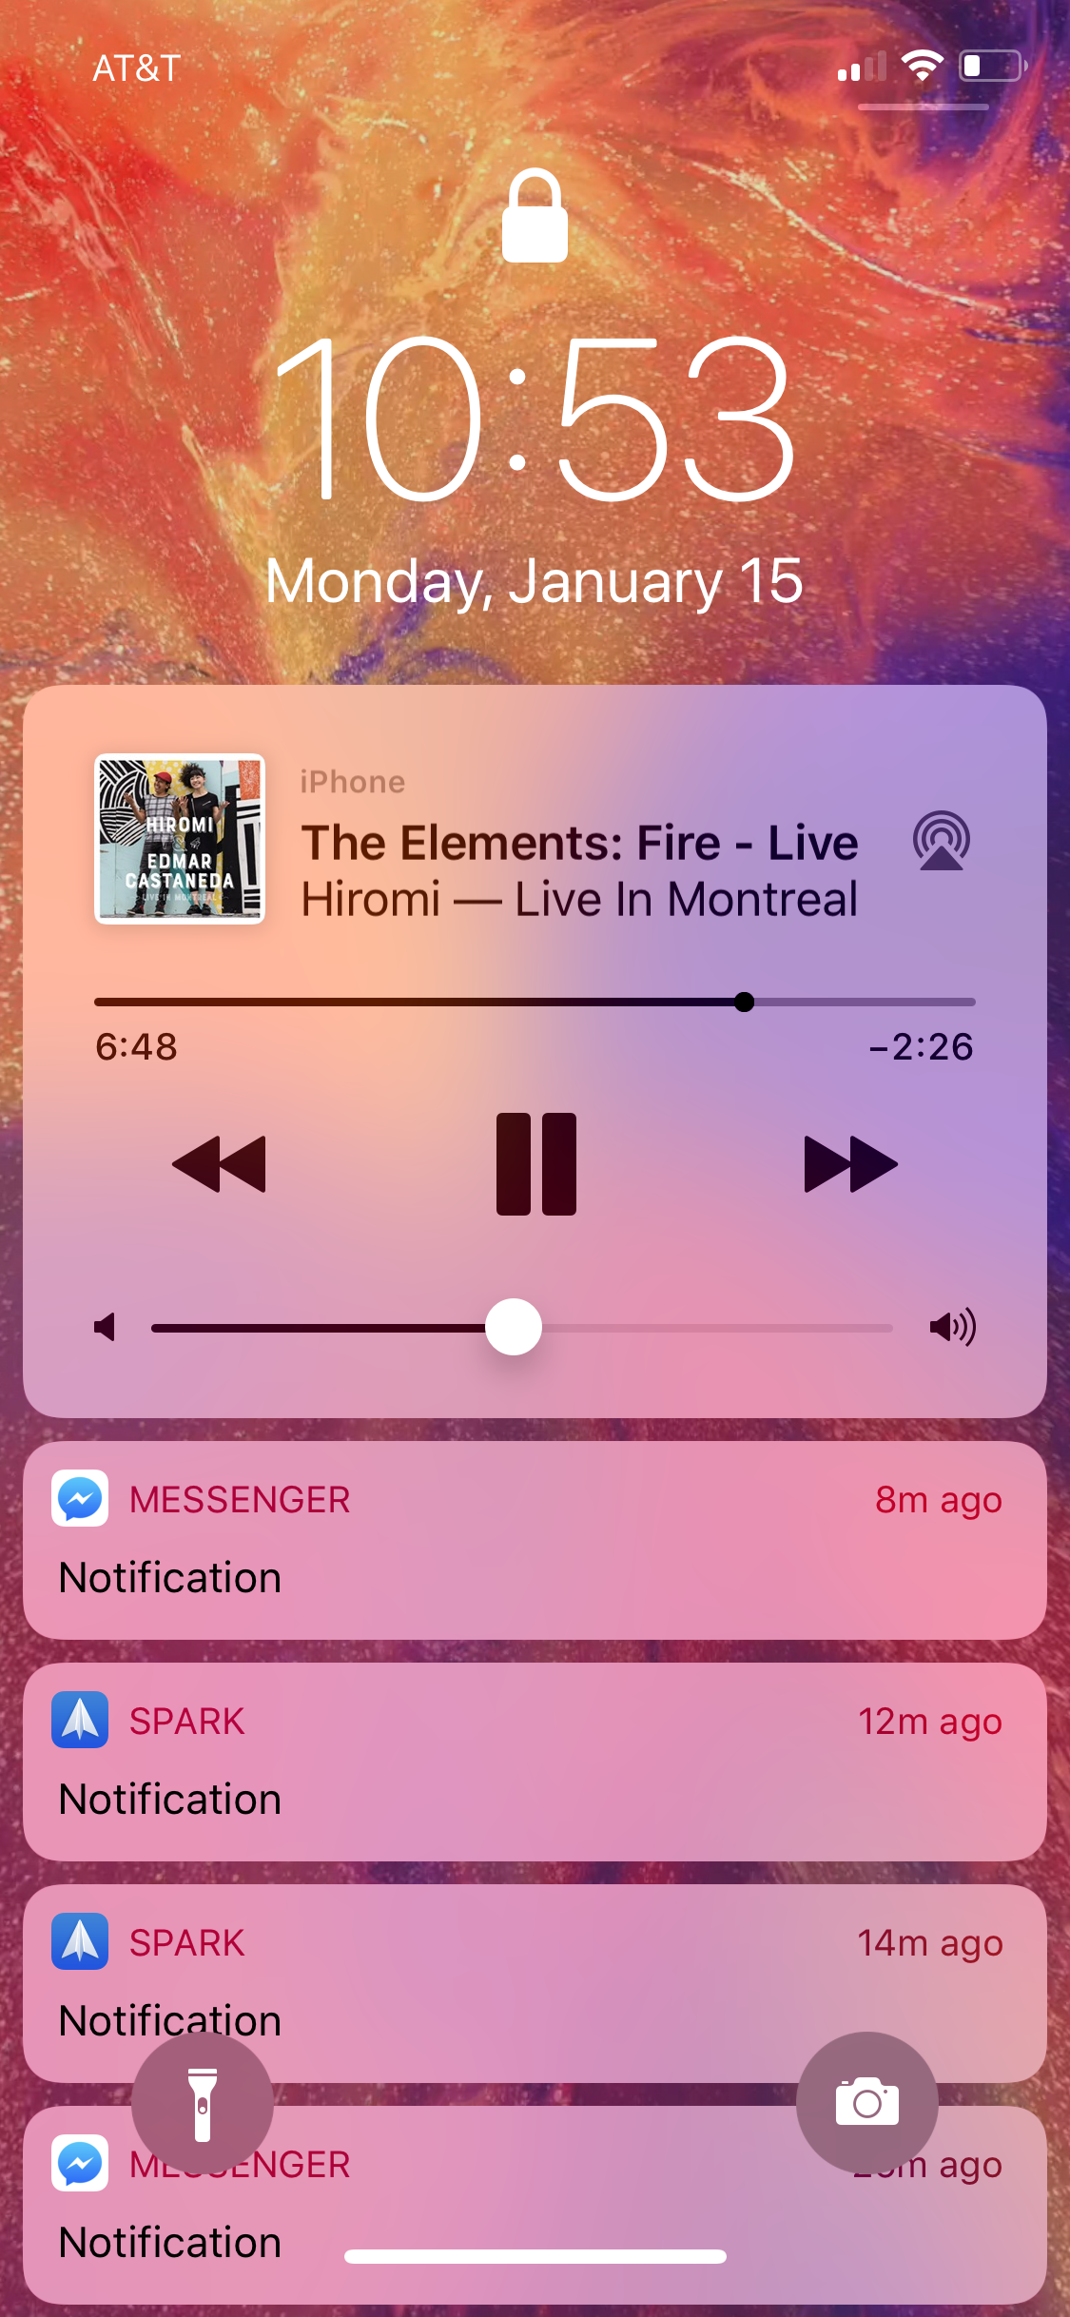
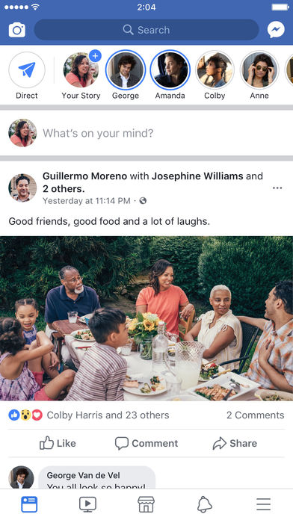
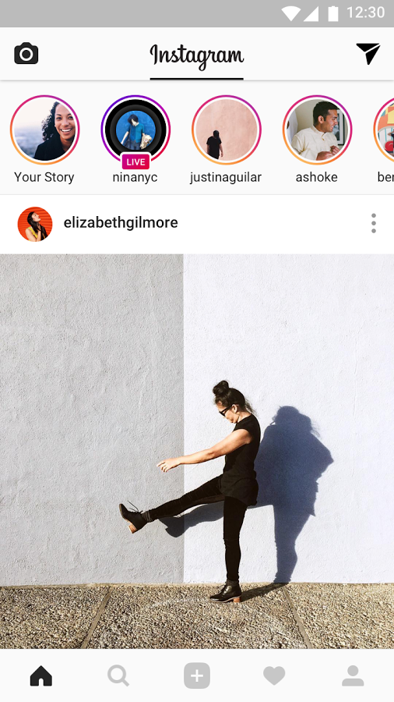
From design to code

Slide 33
From design to code

Slide 34
From design to code
Break down the design.
Choose components for each part.
Code out the components tree and style it.

Slide 36
From design to code: Exercise

Slide 37
From design to code: Exercise

Slide 38
From design to code: Exercise

Slide 39
Assignment 3

Slide 40
Assignment 3
Building the main screen of Pathao.

Slide 41
Assignment 3
Building the main screen of Pathao.
Focuses on the UI.
Notes:
Questions?

